Slide 1
Concurrent Signal Assignments
Nihar Shah
Abhinav Sridhar

Slide 2
Why Concurrency?
Concurrency mainly differentiates Hardware Description Languages from other programming languages like C, Python, MATLAB etc.
Two or more circuits having same inputs will not wait for each other to compute output on a breadboard or PCB
To incorporate this feature of Hardware, all statements inside architecture are concurrent in nature

Slide 3
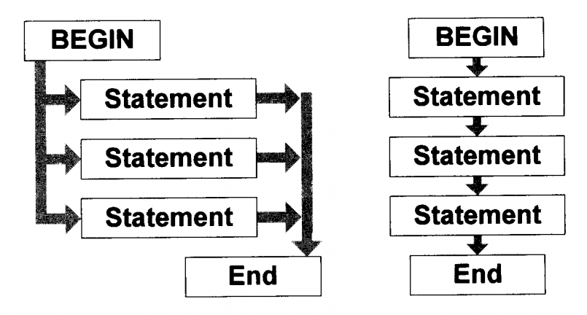

Slide 4
Select Signal Assignment
with <variable> select
<output> <= val1 when i1,
val2 when i2,
val3 when i3,
val4 when others;
If <variable> has value i1, then <output> is chosen to be val1, similarly for i2 and i3, <output will be val2 and val3 respectively
The others case is default case
All options for <variable> are concurrently evaluated and hence there can be no overlapping conditions

Slide 5
Conditional Signal Assignment
<output> <= val1 when <variable> = i1 else
val2 when <variable> = i2 else
val3 when <variable> = i3 else
val4;
Functionality similar to “with … select” statement
Conditions are evaluated sequentially, so this can be modelled as a priority encoder

Slide 6
Designing a 4:1 Mux using different styles

Slide 7
Package and Entity Declaration
library ieee;
use ieee.std_logic_1164.all;
entity mux_4_1 is
port( i0, i1, i2, i3: in std_logic;
sel: in std_logic_vector(1 downto 0);
opt: out std_logic);
end mux_4_1;

Slide 8
Architecture : Simple Dataflow Model
architecture a1 is
begin
opt <= (i0 and (not sel(0) and (not sel(1)) or (i1 and sel(0) and (not sel(1)) or
(i2 and (not sel(0) and sel(1)) or (i3 and sel(0) and sel(1));
end a1;

Slide 9
Architecture: Select Signal Assignment
architecture a2 is
begin
with sel select
opt <= i0 when “00”,
<= i1 when “01”,
<= i2 when “10”,
<= i3 when others;
end a2;

Slide 10
Architecture: Conditional Signal Assignment
architecture a3 is
begin
opt <= i0 when sel = “00” else
i1 when sel = “01” else
i2 when sel “10” else
i3;
end a3;

Slide 11
Exercise for Practice
Simulate this design on Quartus/Modelsim using the testbench and outside circuit provided to you (details will be dealt with later)
Design a 1 bit half adder using all these methods
Help: Concatenation operator in VHDL is the ampersand symbol ( & )

Slide 12
Thank You

